Slide 1
BATCH 2 WEEK 110
SOLID PROPULSION REPORT

Slide 2
MAJOR REMAINING TASKS ACCORDING TO TIMELINE
1. Three grain static test and analyzing of results.
2. Four grain static test and analyzing of results.
https://docs.google.com/spreadsheets/d/1hBBPNcnpQUVeR51bRd35yVVWFX5lDWHhBGYU0TpIXSk/edit#gid=0

Slide 3
THIS WEEK'S OBJECTIVES
1. TWO GRAIN MOTOR SECOND STATIC TEST.
2. MODIFY THE DESIGN OF CASTING TOOLS.
3. START AND FINISH WORKING ON THE 3 GRAIN MOTOR.
4. COOK 2 GRAINS FROM SCRATCH.**
5. 3D PRINT REDESIGNED ELECTRONIC CASING.

Slide 4
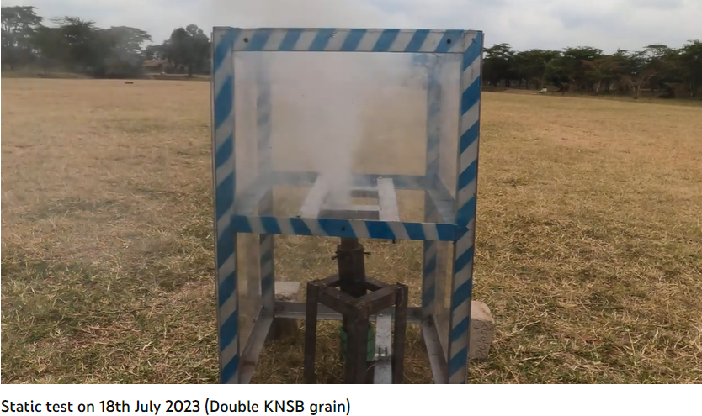
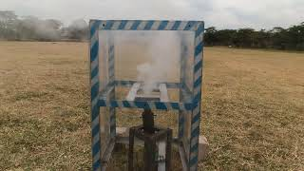
TWO GRAIN MOTOR SECOND STATIC TEST.

Slide 5
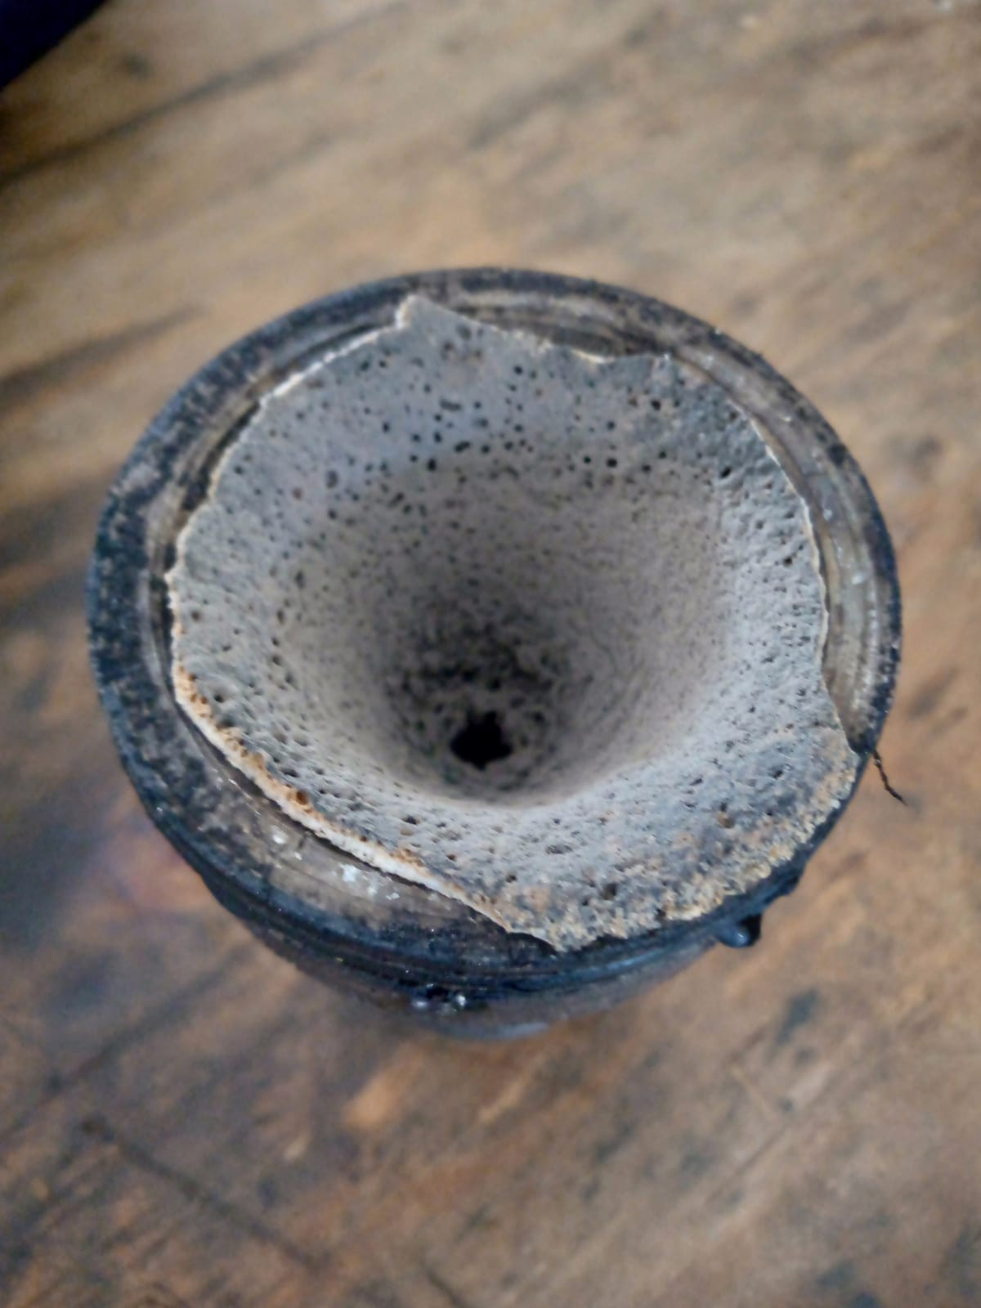
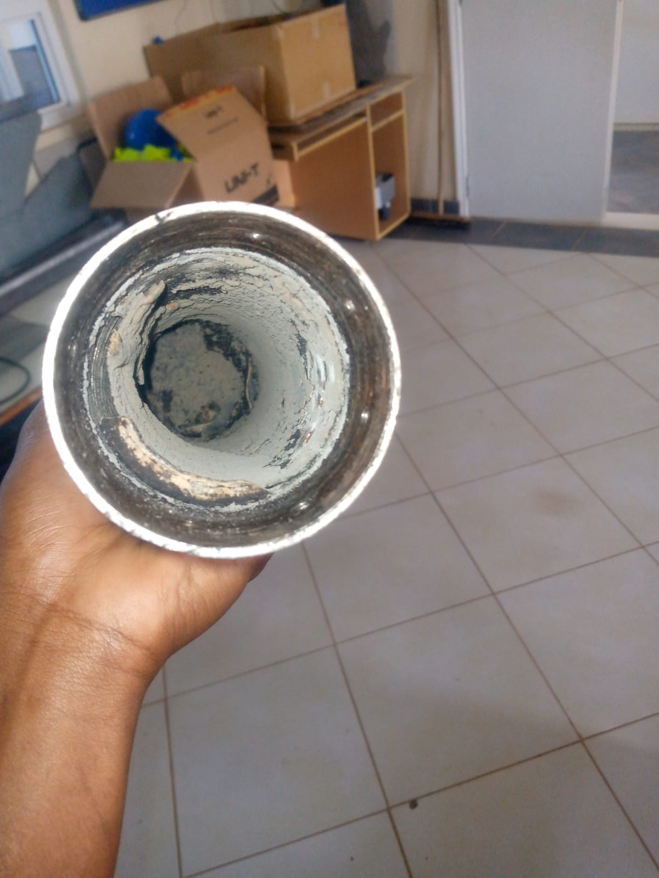
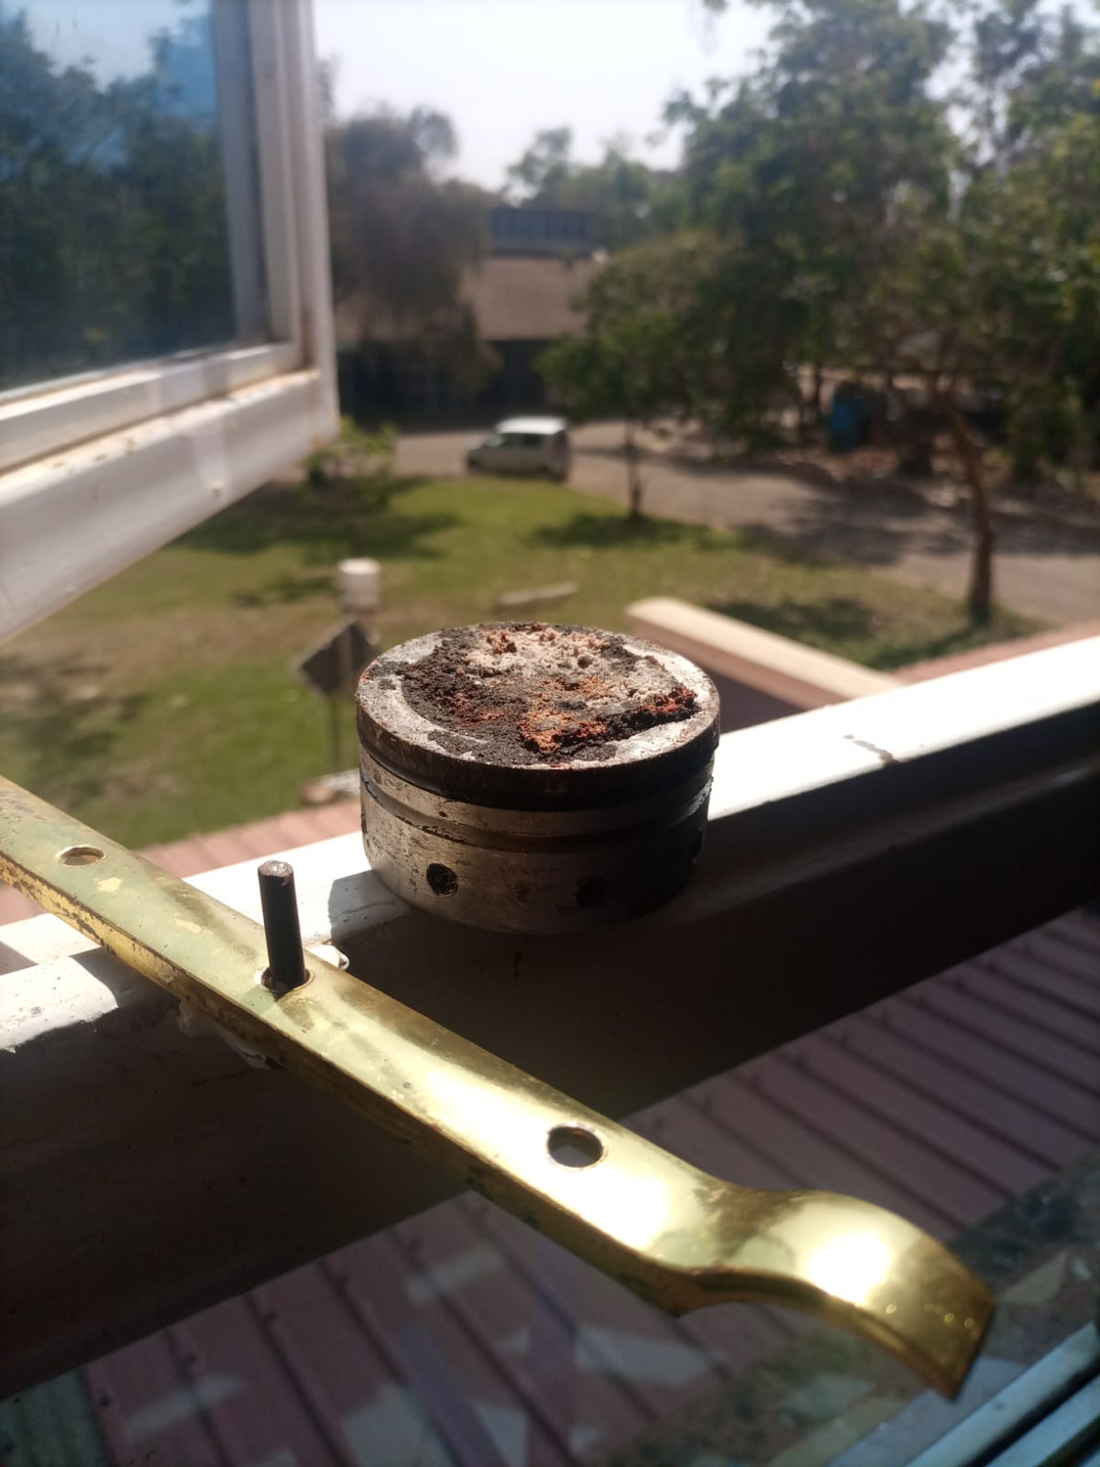
AFTERMATH OF STATIC TEST

Slide 6
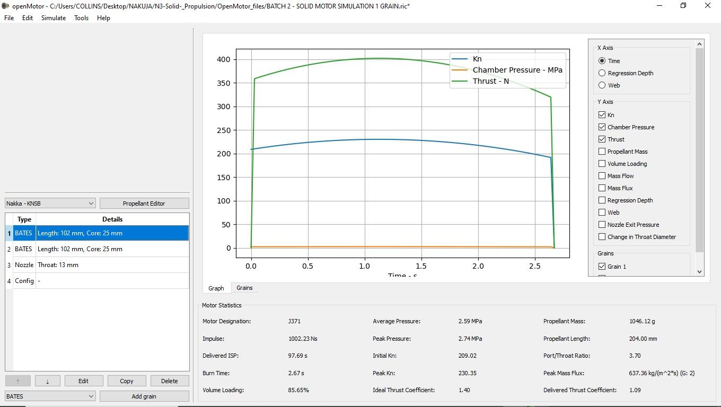
OPEN MOTOR SIMULATION

Slide 7
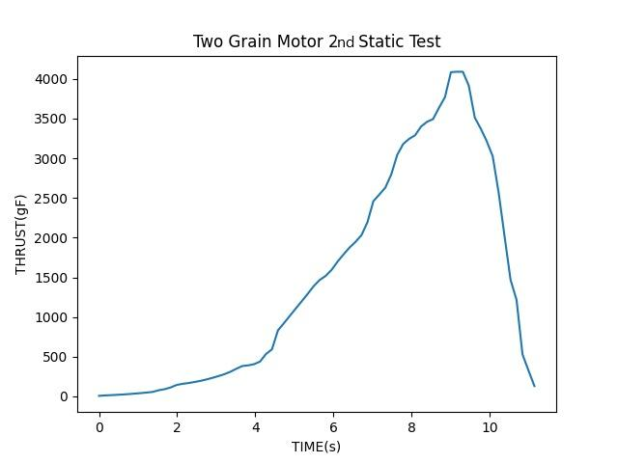
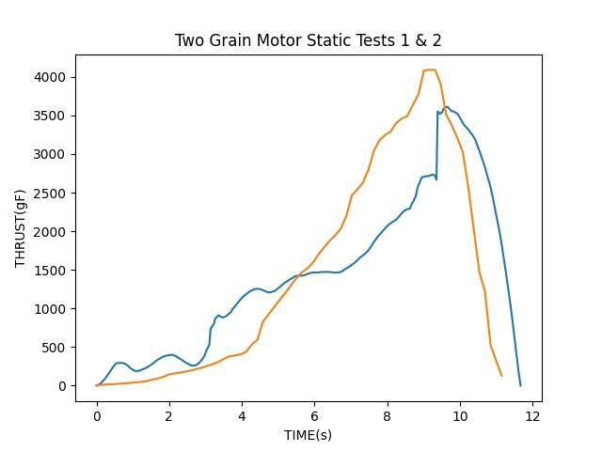
ANALYZING STATIC TEST VALUES
IMPULSE OF 2ND TWO GRAIN TEST: 165.O6 Ns

Slide 8
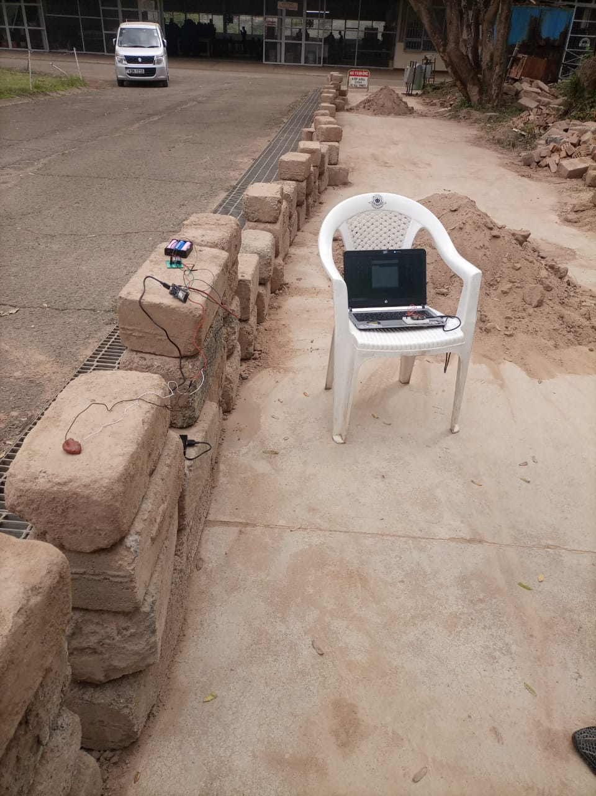
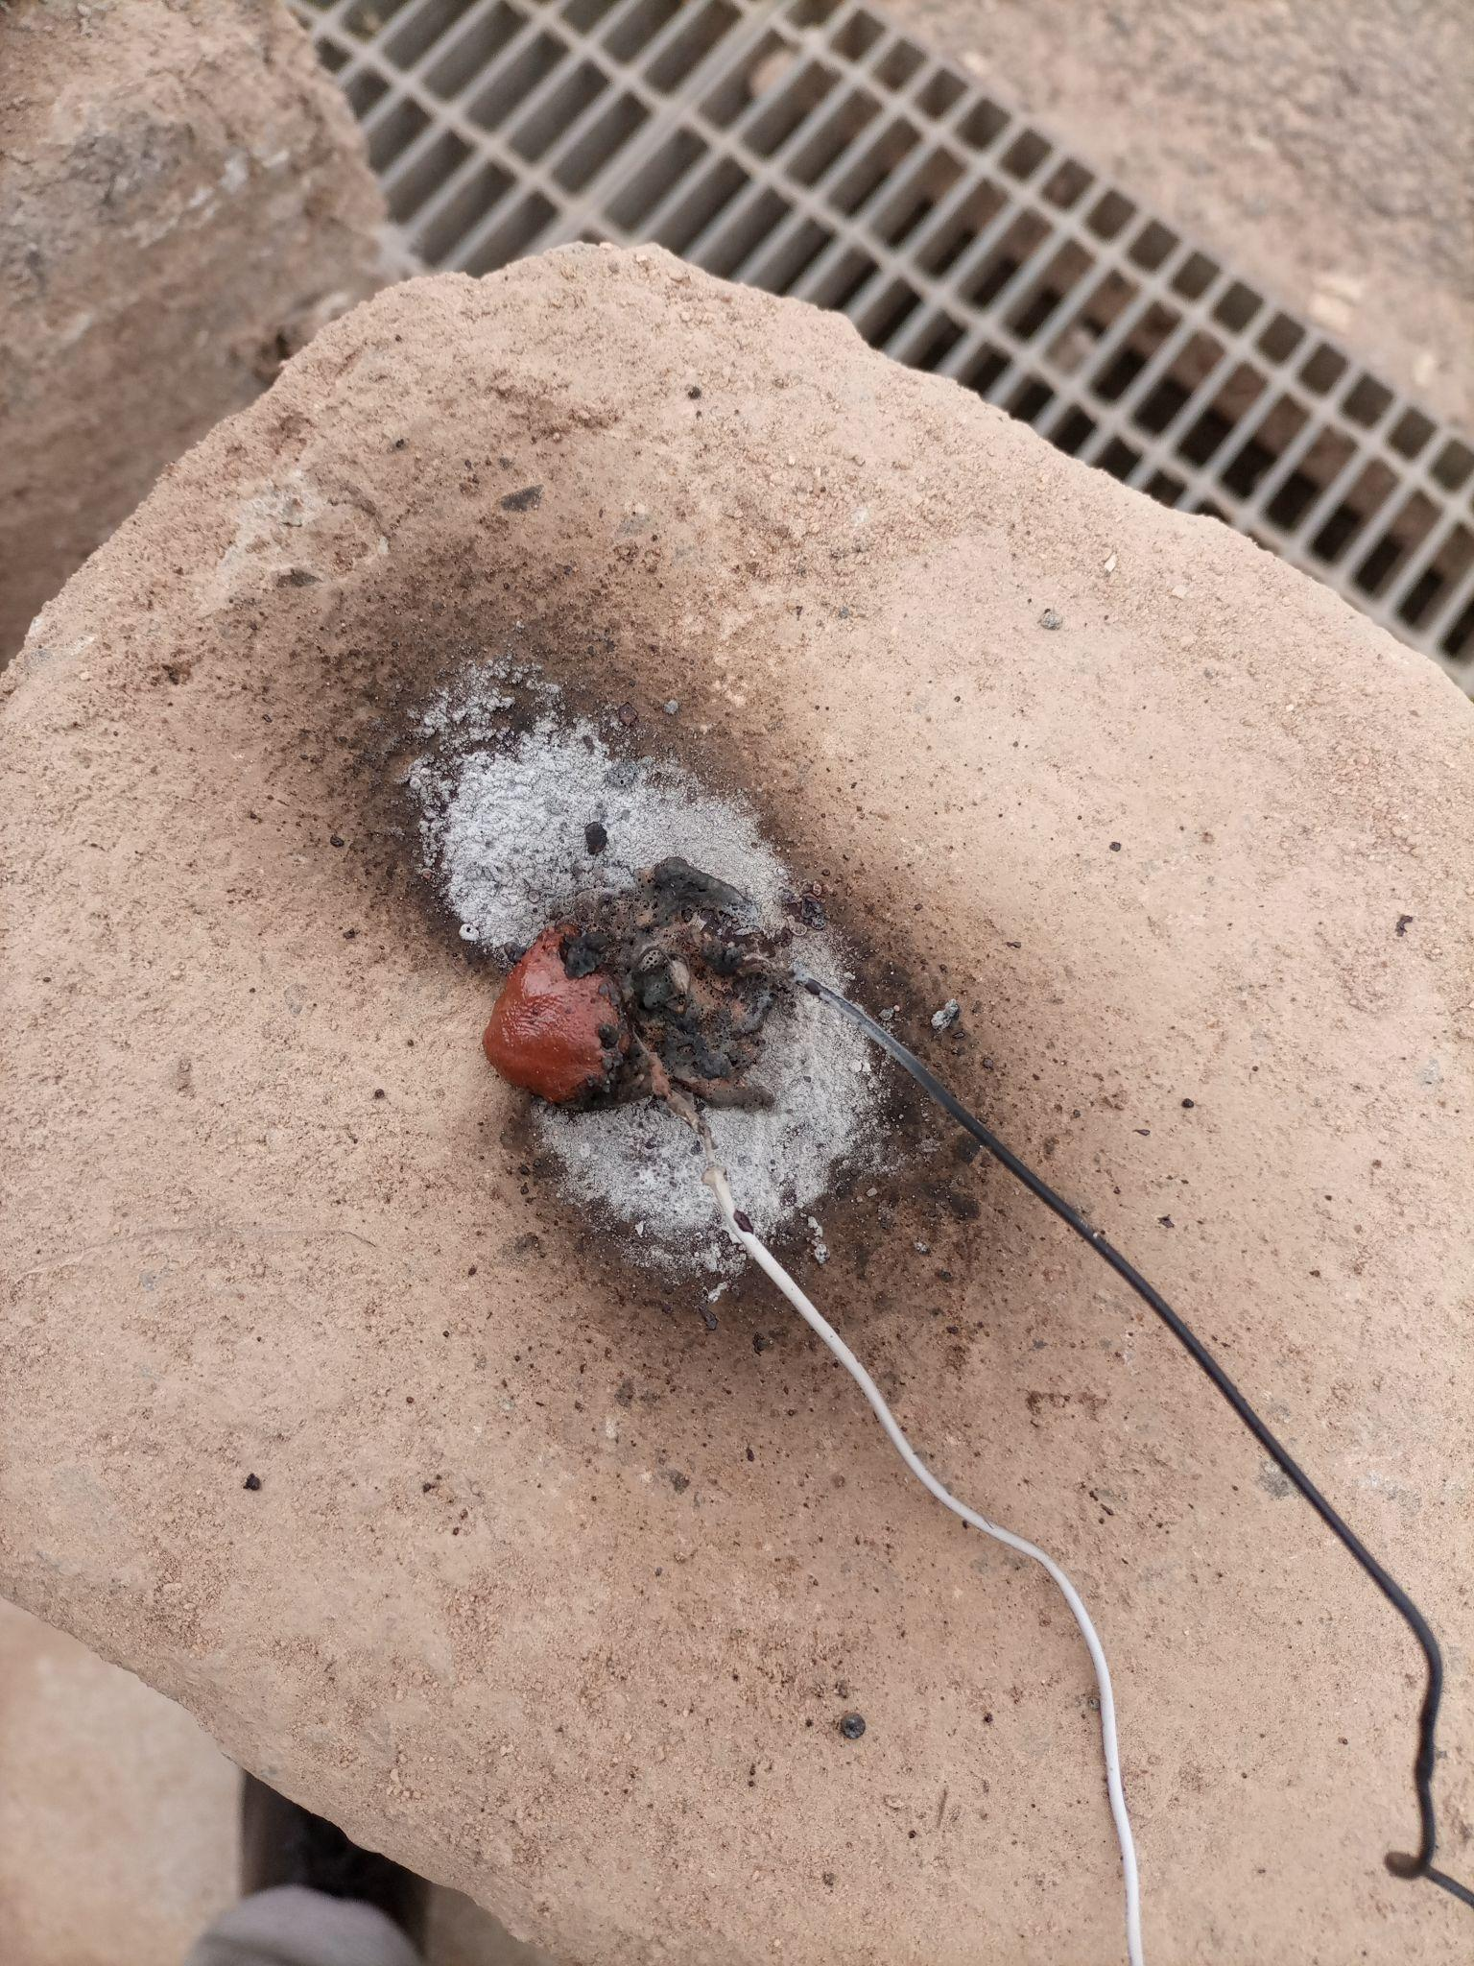
TESTING OF THE GRAIN BURN RATE
https://photos.google.com/share/AF1QipPy1zYaDyku8yvup7_9s7e2EUUXyLsp6BuL0e7tGyP1ksXkVun3unHOr58JC0QGWQ/photo/AF1QipNi4DA2iSjmNpshN0YMY0NlOidJ966pOgjzi1Rp?key=WlFMZ3hRMG85ekpiRjhKQWlCdHdqNVAyV0pnYUt3

Slide 9
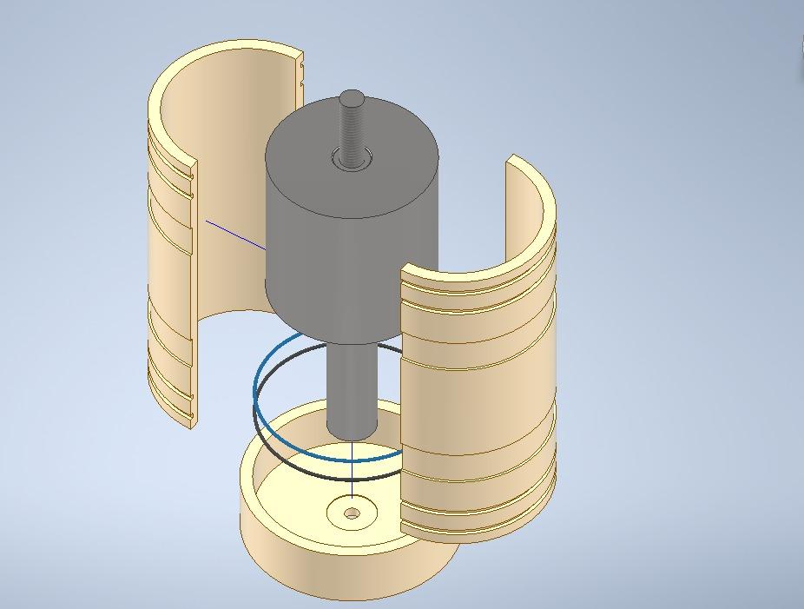
MODIFY THE DESIGN OF CASTING TOOLS

Slide 10
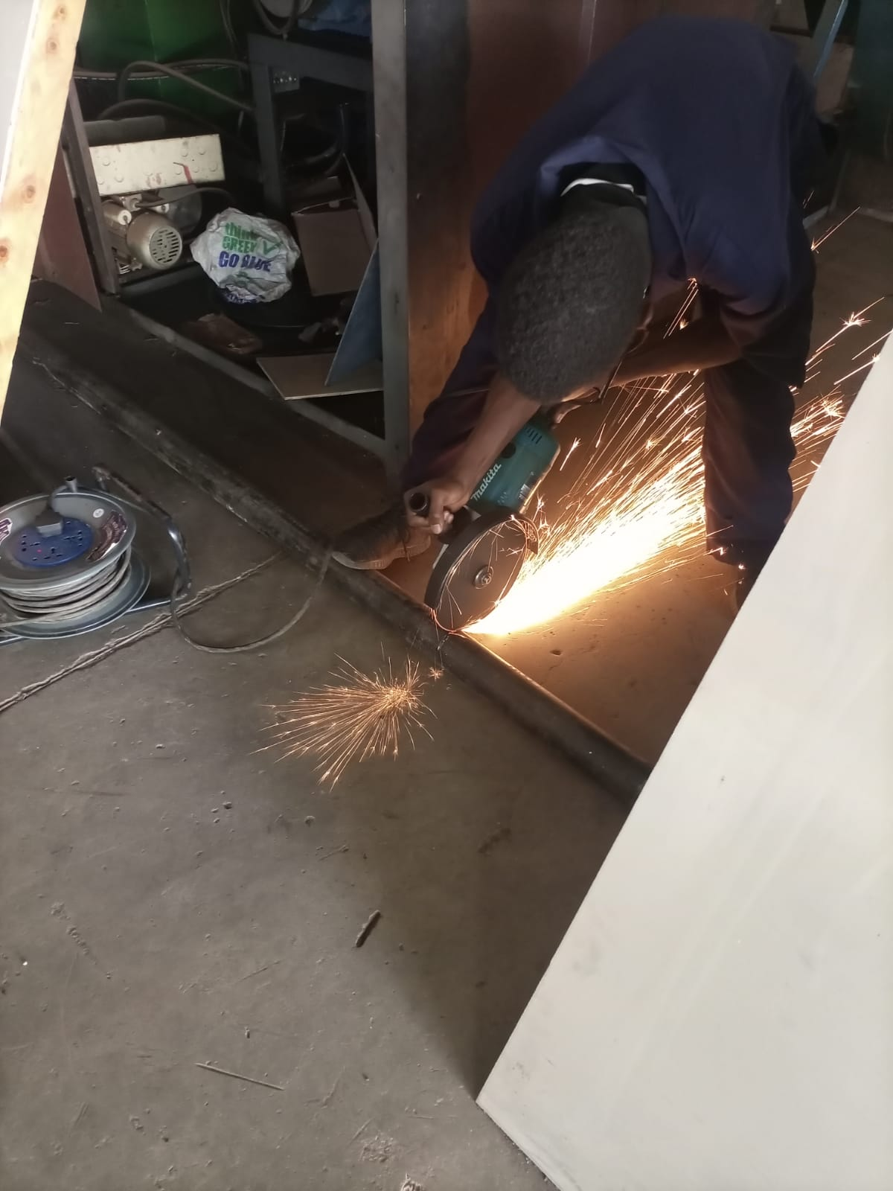
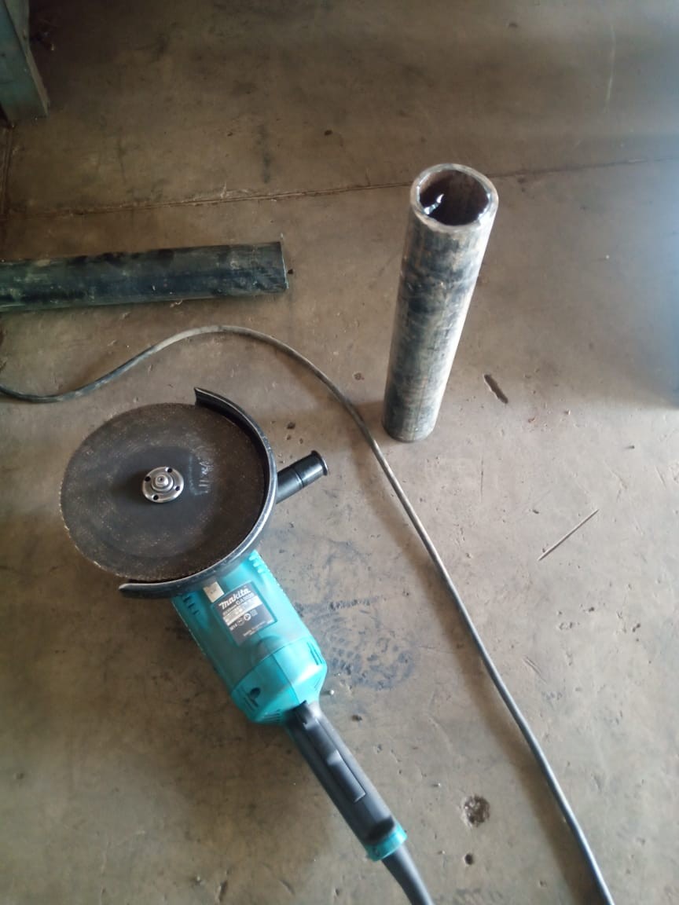
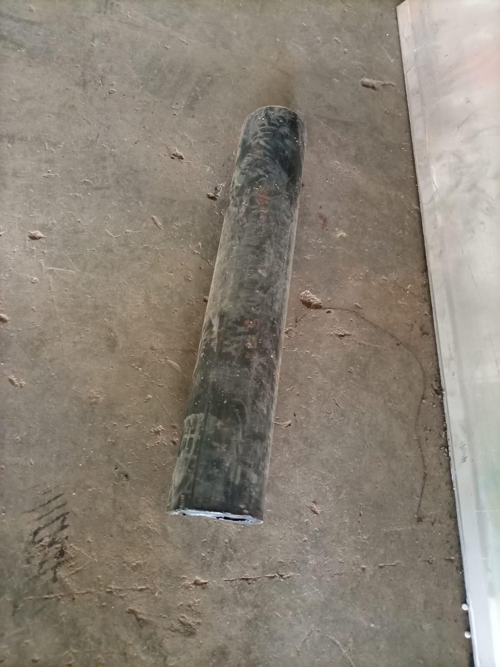
START AND FINISH WORKING ON THE THREE GRAIN MOTOR

Slide 11
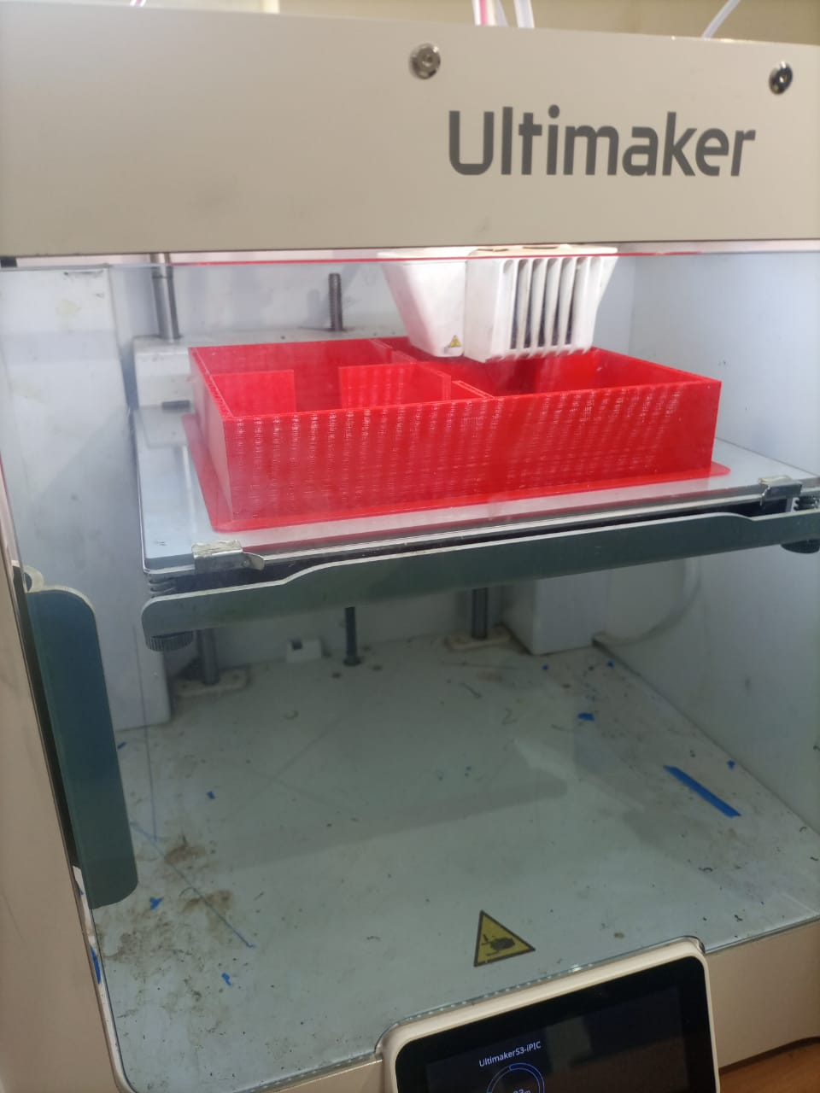
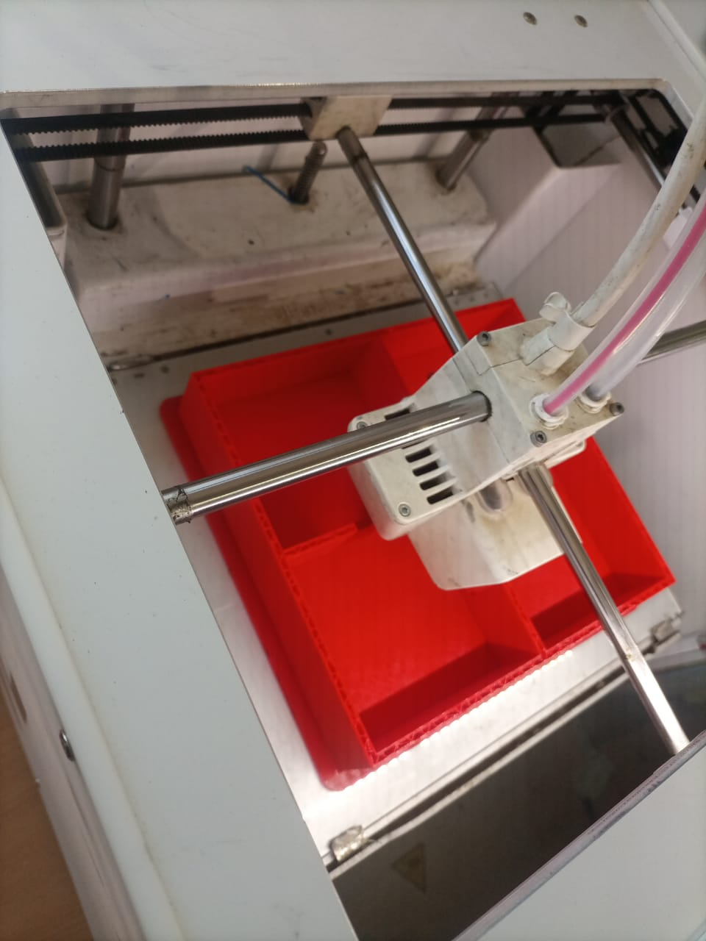
3D PRINTING OF REDESIGNED ELECTRONICS CASING

Slide 12
CHALLENGES
1. FAULTY ENGINE LATHE

Slide 13
NEXT WEEK'S OBJECTIVES
1. COOK 2 FULL GRAINS
2. CONDUCT 3RD 2 GRAIN STATIC TEST.
3. FINISH UP ON THE 3 GRAIN MOTOR.

Slide 14
THANK YOU

